Slide 1
name: Joel kanyi reg no: Com/0054/18 task: REFERENCE MODELS

Slide 2
THE OSI REFERENCE MODEL
The OSI model is based on a proposal developed by the International Standards Organization (ISO) as a first step toward international standardization of the protocols used in the various layers (Day and Zimmermann, 1983). It was revised in 1995 (Day, 1995). The model is called the ISO OSI (Open Systems Interconnection) Reference Model because it deals with connecting open systems—that is, systems that are open for communication with other systems. We will just call it the OSI model for short. The OSI model has seven layers. The principles that were applied to arrive at the seven layers can be briefly summarized as follows:
1. A layer should be created where a different abstraction is needed.
2. Each layer should perform a well-defined function.
3. The function of each layer should be chosen with an eye toward defining internationally standardized protocols.

Slide 3
4. The layer boundaries should be chosen to minimize the information flow across the interfaces.
5. The number of layers should be large enough that distinct functions need not be thrown together in the same layer out of necessity and small enough that the architecture does not become unwieldy

Slide 4
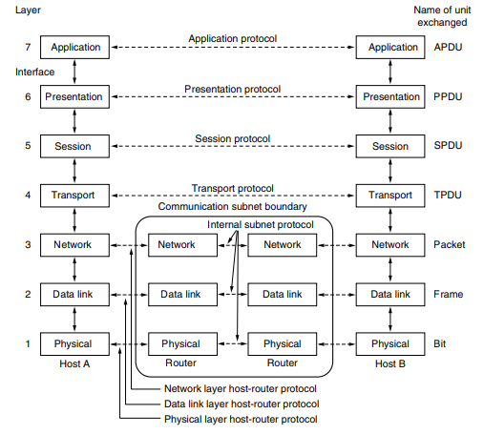

Slide 5
The Physical Layer
The physical layer is concerned with transmitting raw bits over a communication channel. The design issues have to do with making sure that when one side sends a 1 bit it is received by the other side as a 1 bit, not as a 0 bit. Typical questions here are what electrical signals should be used to represent a 1 and a 0, how many nanoseconds a bit lasts, whether transmission may proceed simultaneously in both directions, how the initial connection is established, how it is torn down when both sides are finished, how many pins the network connector has, and what each pin is used for. These design issues largely deal with mechanical, electrical, and timing interfaces, as well as the physical transmission medium, which lies below the physical layer.

Slide 6
The Data Link Layer
The main task of the data link layer is to transform a raw transmission facility into a line that appears free of undetected transmission errors. It does so by masking the real errors so the network layer does not see them. It accomplishes this task by having the sender break up the input data into data frames (typically a few hundred or a few thousand bytes) and transmit the frames sequentially. If the service is reliable, the receiver confirms correct receipt of each frame by sending back an acknowledgement frame. Another issue that arises in the data link layer (and most of the higher layers as well) is how to keep a fast transmitter from drowning a slow receiver in data. Some traffic regulation mechanism may be needed to let the transmitter know when the receiver can accept more data. Broadcast networks have an additional issue in the data link layer: how to control access to the shared channel. A special sublayer of the data link layer, the medium access control sublayer, deals with this problem.

Slide 7
The Network Layer
The network layer controls the operation of the subnet. A key design issue is determining how packets are routed from source to destination. Routes can be based on static tables that are ‘‘wired into’’ the network and rarely changed, or more often they can be updated automatically to avoid failed components. They can also be determined at the start of each conversation, for example, a terminal session, such as a login to a remote machine. Finally, they can be highly dynamic, being determined anew for each packet to reflect the current network load. If too many packets are present in the subnet at the same time, they will get in one another’s way, forming bottlenecks. Handling congestion is also a responsibility of the network layer, in conjunction with higher layers that adapt the load

Slide 8
they place on the network. More generally, the quality of service provided (delay, transit time, jitter, etc.) is also a network layer issue. When a packet has to travel from one network to another to get to its destination, many problems can arise. The addressing used by the second network may be different from that used by the first one. The second one may not accept the packet at all because it is too large. The protocols may differ, and so on. It is up to the network layer to overcome all these problems to allow heterogeneous networks to be interconnected. In broadcast networks, the routing problem is simple, so the network layer is often thin or even nonexistent.

Slide 9
The Transport Layer
The basic function of the transport layer is to accept data from above it, split it up into smaller units if need be, pass these to the network layer, and ensure that the pieces all arrive correctly at the other end. Furthermore, all this must be done efficiently and in a way that isolates the upper layers from the inevitable changes in the hardware technology over the course of time. The transport layer also determines what type of service to provide to the session layer, and, ultimately, to the users of the network. The most popular type of transport connection is an error-free point-to-point channel that delivers messages or bytes in the order in which they were sent. However, other possible kinds of transport service exist, such as the transporting of isolated messages with no guarantee about the order of delivery, and the broadcasting of messages to multiple destinations. The type of service is determined when the connection is established. (As an aside, an error-free channel is completely impossible to achieve; what people really mean by this term is that the error rate is low enough to ignore in practice.) The transport layer is a true end-to-end layer; it carries data all the way from the source to the destination. In other words, a program on the source machine carries on a conversation with a similar program on the destination machine, using the message headers and control messages. In the lower layers, each protocols is between a machine and its immediate neighbors, and not between the ultimate source and destination machines, which may be separated by many routers. The difference between layers 1 through 3, which are chained, and layers 4 through 7, which are end-to-end, is illustrated in Fig. 1-20.

Slide 10
The Session Layer
The session layer allows users on different machines to establish sessions between them. Sessions offer various services, including dialog control (keeping track of whose turn it is to transmit), token management (preventing two parties from attempting the same critical operation simultaneously), and synchronization (checkpointing long transmissions to allow them to pick up from where they left off in the event of a crash and subsequent recovery).

Slide 11
The Presentation Layer
The Presentation Layer Unlike the lower layers, which are mostly concerned with moving bits around, the presentation layer is concerned with the syntax and semantics of the information transmitted. In order to make it possible for computers with different internal data representations to communicate, the data structures to be exchanged can be defined in an abstract way, along with a standard encoding to be used ‘‘on the wire.’’ The presentation layer manages these abstract data structures and allows higher-level data structures (e.g., banking records) to be defined and exchanged.

Slide 12
The Application Layer
The Application Layer The application layer contains a variety of protocols that are commonly needed by users. One widely used application protocol is HTTP (HyperText Transfer Protocol), which is the basis for the World Wide Web. When a browser wants a Web page, it sends the name of the page it wants to the server hosting the page using HTTP. The server then sends the page back. Other application protocols are used for file transfer, electronic mail, and network news.

Slide 13
TCP/IP REFERENCE MODEL
Let us now turn from the OSI reference model to the reference model used in the grandparent of all wide area computer networks, the ARPANET, and its successor, the worldwide Internet. Although we will give a brief history of the ARPANET later, it is useful to mention a few key aspects of it now. The ARPANET was a research network sponsored by the DoD (U.S. Department of Defense). It eventually connected hundreds of universities and government installations, using leased telephone lines. When satellite and radio networks were added later, the existing protocols had trouble interworking with them, so a new reference architecture was needed. Thus, from nearly the beginning, the ability to connect multiple networks in a seamless way was one of the major design goals. This architecture later became known as the TCP/IP Reference Model, after its two primary protocols. It was first described by Cerf and Kahn (1974), and later refined and defined as a standard in the Internet community (Braden, 1989). The design philosophy behind the model is discussed by Clark (1988). Given the DoD’s worry that some of its precious hosts, routers, and internetwork gateways might get blown to pieces at a moment’s notice by an attack from the Soviet Union, another major goal was that the network be able to survive loss of subnet hardware, without existing conversations being broken off. In other words, the DoD wanted connections to remain intact as long as the source and destination machines were functioning, even if some of the machines or transmission lines in between were suddenly put out of operation. Furthermore, since applications with divergent requirements were envisioned, ranging from transferring files to real-time speech transmission, a flexible architecture was needed.

Slide 14
The Link Layer
All these requirements led to the choice of a packet-switching network based on a connectionless layer that runs across different networks. The lowest layer in the model, the link layer describes what links such as serial lines and classic Ethernet must do to meet the needs of this connectionless internet layer. It is not really a layer at all, in the normal sense of the term, but rather an interface between hosts and transmission links. Early material on the TCP/IP model has little to say about it.

Slide 15
The Internet Layer
The internet layer is the linchpin that holds the whole architecture together. Its job is to permit hosts to inject packets into any network and have them travel independently to the destination (potentially on a different network). They may even arrive in a completely different order than they were sent, in which case it is the job of higher layers to rearrange them, if in-order delivery is desired. Note that ‘‘internet’’ is used here in a generic sense, even though this layer is present in the Internet.

Slide 16
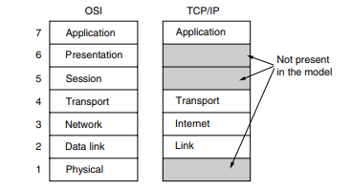

Slide 17
The analogy here is with the (snail) mail system. A person can drop a sequence of international letters into a mailbox in one country, and with a little luck, most of them will be delivered to the correct address in the destination country. The letters will probably travel through one or more international mail gateways along the way, but this is transparent to the users. Furthermore, that each country (i.e., each network) has its own stamps, preferred envelope sizes, and delivery rules is hidden from the users. The internet layer defines an official packet format and protocol called IP (Internet Protocol), plus a companion protocol called ICMP (Internet Control Message Protocol) that helps it function. The job of the internet layer is to deliver IP packets where they are supposed to go. Packet routing is clearly a major issue here, as is congestion (though IP has not proven effective at avoiding congestion).

Slide 18
The Transport Layer
The layer above the internet layer in the TCP/IP model is now usually called the transport layer. It is designed to allow peer entities on the source and destination hosts to carry on a conversation, just as in the OSI transport layer. Two end-to-end transport protocols have been defined here. The first one, TCP (Transmission Control Protocol), is a reliable connection-oriented protocol that allows a byte stream originating on one machine to be delivered without error on any other machine in the internet. It segments the incoming byte stream into discrete messages and passes each one on to the internet layer. At the destination, the receiving TCP process reassembles the received messages into the output stream. TCP also handles flow control to make sure a fast sender cannot swamp a slow receiver with more messages than it can handle. The second protocol in this layer, UDP (User Datagram Protocol), is an unreliable, connectionless protocol for applications that do not want TCP’s sequencing or flow control and wish to provide their own. It is also widely used for one-shot, client-server-type request-reply queries and applications in which prompt delivery is more important than accurate delivery, such as transmitting speech or video. The relation of IP, TCP, and UDP is shown in Fig. 1-22. Since the model was developed, IP has been implemented on many other networks.

Slide 19
The Application Layer
The TCP/IP model does not have session or presentation layers. No need for them was perceived. Instead, applications simply include any session and presentation functions that they require. Experience with the OSI model has proven this view correct: these layers are of little use to most applications. On top of the transport layer is the application layer. It contains all the higher-level protocols. The early ones included virtual terminal (TELNET), file transfer (FTP), and electronic mail (SMTP). Many other protocols have been added to these over the years.

Slide 20
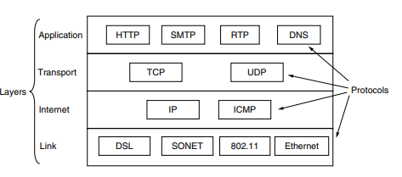

Slide 21
COMPARISON OF OSI AND TCP/IP REFERENCE MODELS
1.Area of connectionless versus connection-oriented communication.
The OSI model supports both connectionless and connection oriented communication in the network layer, The TCP/IP model supports only one mode in the network layer (connectionless) but both in the transport layer

